Slide 1
The Revelation of Jesus Christ
Vision 2 , Part 6 (9:13-10:4) - Trumpet 6, Part 1

Slide 2
Trumpet #5 - the rise of Islam and the Arab opposition to Byzantium

Slide 3
“One woe is past. Behold, still two more woes are coming after these things.”
–Revelation 9:13
Notes:
Trumpet 5 - Woe #1
Trumpet 6 - Woe #2 (Revelation 11:14, “The second woe is past. Behold, the third woe is coming quickly.”)
Trumpet 7 - Woe #3

Slide 4
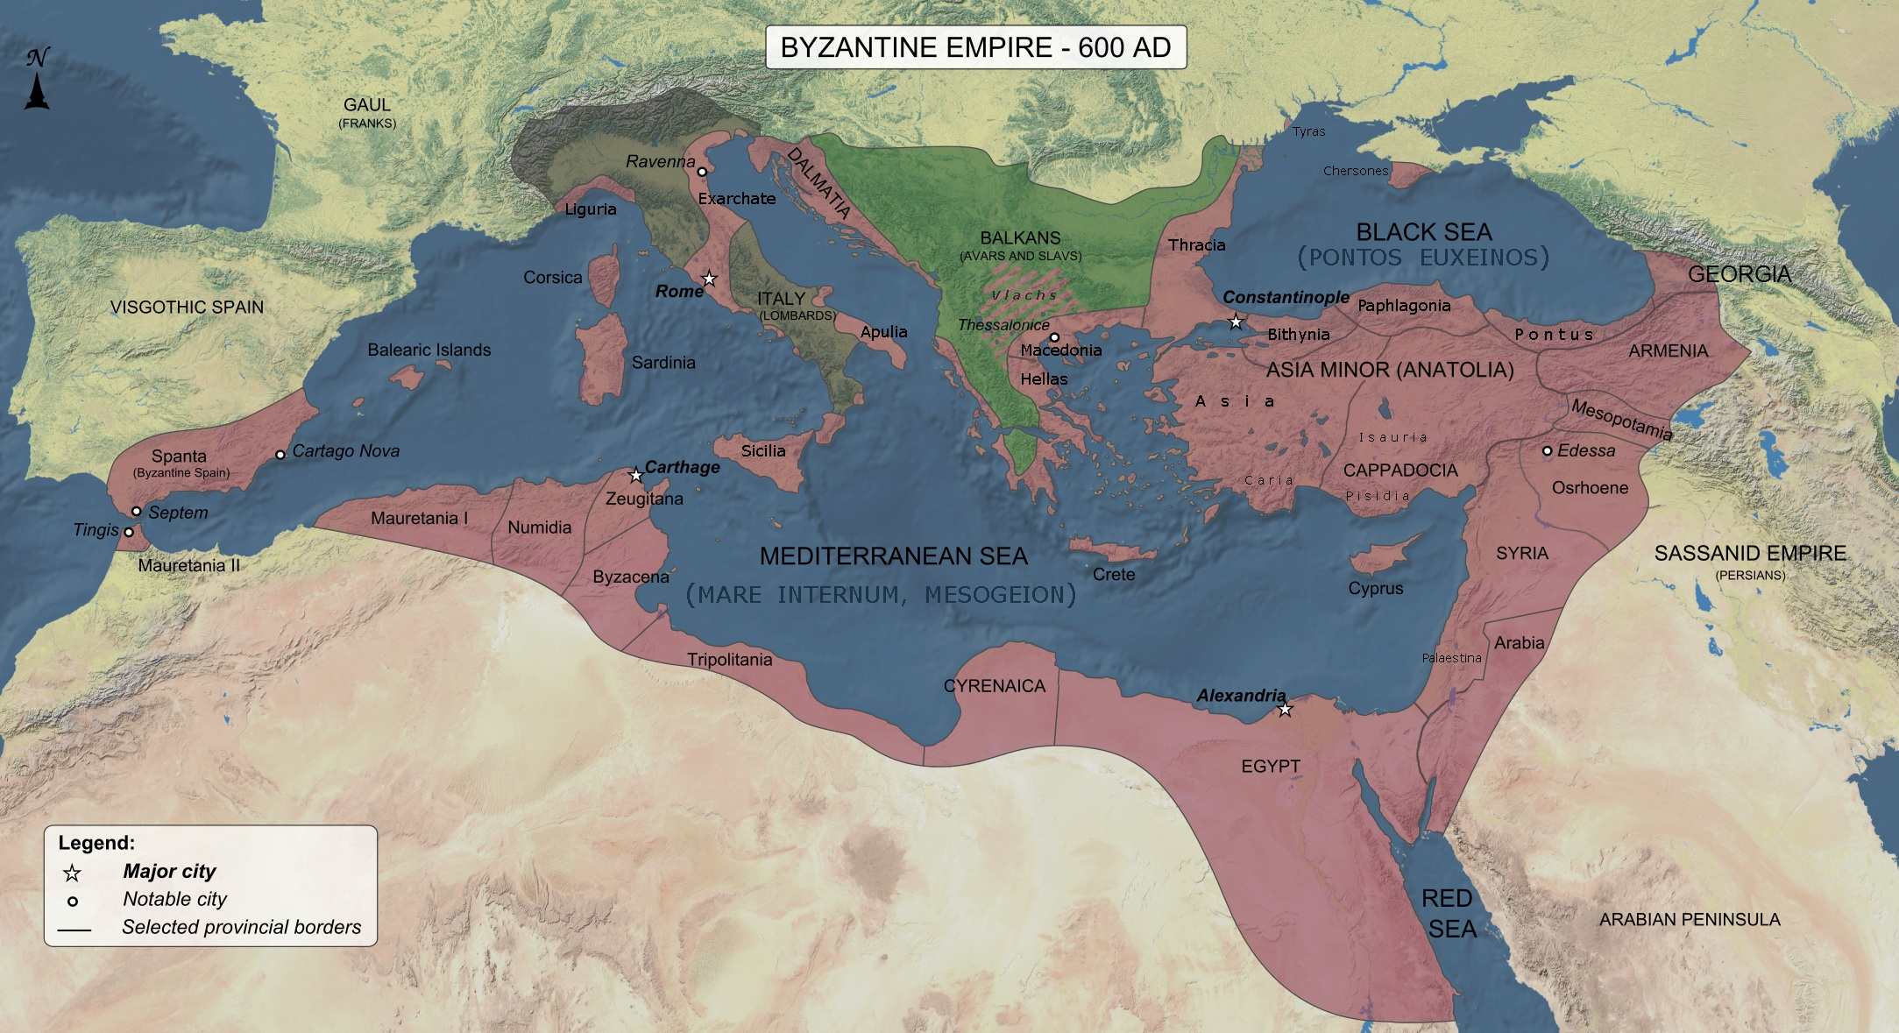

Slide 6
Trumpet #6
The rise of the Turkish power, Constantinople falls, the Byzantine Empire ends.
The fall of Constantinople sets the stage for momentous events in European Christendom (11:1-13).
11:14: “The second woe is past. Behold, the third woe is coming quickly.”
Notes:
The rise of the Turkish power, Constantinople falls, the Byzantine Empire ends.
The fall of Constantinople sets the stage for momentous events in European Christendom (11:1-13).
11:14: “The second woe is past. Behold, the third woe is coming quickly.”

Slide 7
6, 6, 6
Sixth seal prepares God’s people for the tribulation to come
Sixth trumpet signals that the end of the world approaches
Sixth bowl warns God’s people to prepare
Notes:
Sixth seal prepares God’s people for the tribulation to come
Sixth trumpet signals that the end of the world approaches
Sixth bowl warns God’s people to prepare

Slide 8
Trumpet #7 - Day of Judgment
“…coming quickly” - catchphrase for the return of Jesus
11:18, “The nations were angry, and Your wrath has come, And the time of the dead, that they should be judged, And that You should reward Your servants the prophets and the saints, And those who fear Your name, small and great, And should destroy those who destroy the earth.”
Proleptic: to see something in the future as if it is happening in the present
The seventh trumpet is the last trumpet in Revelation: “…in a moment, in the twinkling of an eye, at the last trumpet….” (1 Corinthians 15:52)
Trumpet #7 signals the end of Vision #2 (4:1-11:18)
Notes:
“…coming quickly” - catchphrase for the return of Jesus
11:18, “The nations were angry, and Your wrath has come, And the time of the dead, that they should be judged, And that You should reward Your servants the prophets and the saints, And those who fear Your name, small and great, And should destroy those who destroy the earth.”
Proleptic: to see something in the future as if it is happening in the present
The seventh trumpet is the last trumpet in Revelation: “…in a moment, in the twinkling of an eye, at the last trumpet….” (1 Corinthians 15:52)
Trumpet #7 signals the end of Vision #2 (4:1-11:18)

Slide 9
Trumpet #6 - the rise of the Turkish power
Notes:
Revelation 9:13-19
13 Then the sixth angel sounded: And I heard a voice from the four horns of the golden altar which is before God,
14 saying to the sixth angel who had the trumpet, "Release the four angels who are bound at the great river Euphrates."
15 So the four angels, who had been prepared for the hour and day and month and year, were released to kill a third of mankind.
16 Now the number of the army of the horsemen was two hundred million; I heard the number of them.
17 And thus I saw the horses in the vision: those who sat on them had breastplates of fiery red, hyacinth blue, and sulfur yellow; and the heads of the horses were like the heads of lions; and out of their mouths came fire, smoke, and brimstone.
18 By these three plagues a third of mankind was killed—by the fire and the smoke and the brimstone which came out of their mouths.
19 For their power is in their mouth and in their tails; for their tails are like serpents, having heads; and with them they do harm.

Slide 10
Trumpet #6 - What John Saw
“a voice from the four horns of the golden altar” — remember 8:3-5
“Release the four angels” - four destructive forces
“bound at the River Euphrates” - prevented from crossing until the appointed time
“River Euphrates” - a restraint against the powers of the East
Notes:
“a voice from the four horns of the golden altar” — remember 8:3-5
8:3-5, “Then another angel, having a golden censer, came and stood at the altar. He was given much incense, that he should offer it with the prayers of all the saints upon the golden altar which was before the throne. And the smoke of the incense, with the prayers of the saints, ascended before God from the angel’s hand. Then the angel took the censer, filled it with fire from the altar, and threw it to the earth. And there were noises, thunderings, lightnings, and an earthquake.”
A reminder that the trumpets are God’s judgment of the Roman Empire in response to the prayers of His people.
“Release the four angels” - four destructive forces
“bound at the River Euphrates” - prevented from crossing until the appointed time
“River Euphrates” - a restraint against the powers of the East

Slide 11
“hour…day…month…year”
Points to a precise time (applying the day – year theory)
“hour”: 1/12 day (Jesus, “are there not 12 hours in a day?”) =1 month (1/12 of a year)
"month": 30 days = 30 years
“day” = 1 day =1 year
“year” - a solar year, 365.25 days = 365 ¼ days or 365 years and 3 months
Time period of 396 years and 4 months
Notes:
Points to a precise time (applying the day – year theory)
“hour”: 1/12 day (Jesus, “are there not 12 hours in a day?”) =1 month (1/12 of a year)
"month": 30 days = 30 years
“day” = 1 day =1 year
“year” - a solar year, 365.25 days = 365 ¼ days or 365 years and 3 months
the original Greek is not the typical 365-day year – it is a solar year (365.25 days)
365 ¼ days or 365 years and 3 months
Time period of 396 years and 4 months

Slide 12
The army
“two hundred million” cavalry - an overwhelming host
“breastplates of fiery red, hyacinth blue, and sulfur yellow” - strong emphasis on sulfur
“By these three plagues a third of mankind was killed” - a significant, but not complete, loss of life
“For their power is in their mouth and in their tails”
Notes:
“two hundred million” cavalry - an overwhelming host
“breastplates of fiery red, hyacinth blue, and sulfur yellow” - strong emphasis on sulfur
“By these three plagues a third of mankind was killed” - a significant, but not complete, loss of life
“For their power is in their mouth and in their tails”

Slide 13
Byzantine Empire in 1025

Slide 14
Notes:
Migrated from the east side of the Caspian Sea southwest to conquer the kingdoms of Persia and India (see Durant, A of F, pp. 203-204).

Slide 15
The Seljuk Turks
1055 -- Conquered Baghdad
1057 -- Cross the river Euphrates in January (beginning the 396 years and four months)
1071 - Battle of Manzikert shows the Seljuk Turks to be a threat against Byzantium
1095 - Pope Urban II issues call for the First Crusade
Conquered territory well into Asia Minor by the end of the 12th century
Notes:
1055 -- Conquered Baghdad
1057 -- Cross the river Euphrates in January (beginning the 396 years and four months)
1071 - Battle of Manzikert shows the Seljuk Turks to be a threat against Byzantium
1095 - Pope Urban II issues call for the First Crusade
Byzantine emperor Alexios I, Komnenos requests aid from Pope Urban II for help against the invading Turks
Pope Urban issues a call for the First Crusade
Conquered territory well into Asia Minor by the end of the 12th century
Conquered territory well into Asia Minor by the end of the 12th century.
“...the educated city-dweller could scarcely avoid a feeling of disgust at the presence of these coarse and uncouth sons of the steppes. The chroniclers of the time draw a sharp contrast between the (Turkish) Sultans and their people : 'Their princes are warlike, provident, firm, just and distinguished by excellent qualities…the nation is cruel, wild, coarse and ignorant.' To make matters worse…the regular Seljuk forces, cavalrymen of slave origin, were followed by swarms of 'Turkomans,’ free and undisciplined nomads seeking pasture and plunder, who raided estates, destroyed crops, robbed merchant caravans, and fought other nomads, such as Kurds and Bedouin Arabs, for the possession of wells and grazing-lands” (Saunders, A History of Medieval Islam, p. 148).

Slide 16
Ottoman Turks rise to power
1361 -- Turkish army invades Thrace and capture Adrianople, attacks continue throughout the Balkans
1366 -- Murad I, Turkish sultan, makes Adrianople his capital
1422 -- Murad II lays siege to Constantinople; abandoned siege due to Balkan revolt – city pays tribute to Turks
Notes:
1361 -- Turkish army invades Thrace and capture Adrianople, attacks continue throughout the Balkans
1366 -- Murad I, Turkish sultan, makes Adrianople his capital
1422 -- Murad II lays siege to Constantinople; abandoned siege due to Balkan revolt – city pays tribute to Turks

Slide 17
May 29, 1453
Constantinople falls to the Ottoman Turks
The use of cannons and gunpowder gave the edge to the Turkish army
The final iteration of the Roman Empire is destroyed
January, 1057 - May, 1453 = 396 years and four months
Notes:
Constantinople falls to the Ottoman Turks
The use of cannons and gunpowder gave the edge to the Turkish army
The final iteration of the Roman Empire is destroyed
January, 1057 - May, 1453 = 396 years and four months

Slide 18
“The capture of Constantinople shook every throne in Europe. The bulwark had fallen that had protected Europe from Asia for over a thousand years.”
–Will Durant, The Reformation, p. 183

Slide 19
“The fear which this Islamic aggression engendered in Europe was an essential background to the Reformation, convincing many on both sides that God’s anger was poised to strike down the Christian world, and so making it all the more essential to please God by affirming the right form of Christian belief against other Christians. It is impossible to understand the mood of sixteenth-century Europe without bearing in mind the deep anxiety inspired by the Ottoman Empire.”
–Diarmid McCulloch, The Reformation, p. 57

Slide 20
“The rest of mankind, who were not killed by these plagues, did not repent of the works of their hands nor give up worshiping demons and idols of gold and silver and bronze and stone and wood, which cannot see or hear or walk, nor did they repent of their murders or their sorceries or their sexual immorality or their thefts.”
–Revelation 9:20-21

Slide 21
An end, but not the end
“but the rest of mankind” - those who were not directly affected by these events, specifically the Latin Church
Heavy emphasis on apostasy and idolatry
“nor did they repent of their murders” - the Crusades, the Inquisitions
“...or their sorceries” - Latin church claimed miraculous power
“...or their thefts”
Notes:
“but the rest of mankind” - those who were not directly affected by these events, specifically the Latin Church
Heavy emphasis on apostasy and idolatry
Eastern Orthodoxy was, and remains, heavily iconographic in its worship.
The Church of Rome also employed idolatry in the statues of saints.
“nor did they repent of their murders”
These four hundred years were characterized by the Crusades and the various Inquisitions.
Some estimate that 50 million people were killed by the authority of the church of Rome.
“...or their sorceries” - Latin church claimed miraculous power
The doctrine of transubstantiation: the bread and wine of communion is miraculously transformed into the body and blood of Jesus.
Saints must perform several miracles in order to be canonized.
“...or their thefts”
land and wealth were seized by the church of Rome in the name of Jesus Christ.

Slide 22
Chapter 10 - John’s testimony must continue
Notes:
Revelation 10:1-4
1 I saw still another mighty angel coming down from heaven, clothed with a cloud. And a rainbow was on his head, his face was like the sun, and his feet like pillars of fire.
2 He had a little book open in his hand. And he set his right foot on the sea and his left foot on the land,
3 and cried with a loud voice, as when a lion roars. When he cried out, seven thunders uttered their voices.
4 Now when the seven thunders uttered their voices, I was about to write; but I heard a voice from heaven saying to me, "Seal up the things which the seven thunders uttered, and do not write them."

Slide 23
John sees “another mighty angel”
“clothed with a cloud” - a divine mission
“...a rainbow was on his head” - fidelity of God to His promises
“face was like the sun” - countenance like one who has been in the presence of God
“feet like pillars of fire” -- trampling judgment of God
“a little book open in his hand” - a revelation available to all people
“right foot on the sea and his left foot on the land” - a universal message relevant to all.
Notes:
“clothed with a cloud” - a divine mission
“...a rainbow was on his head” - fidelity of God to His promises
“face was like the sun” - countenance like one who has been in the presence of God
“feet like pillars of fire” -- trampling judgment of God
“a little book open in his hand” - a revelation available to all people
“open” – made available for people
All the seals were opened by the Lord – everything was available
“right foot on the sea and his left foot on the land” - a universal message relevant to all.

Slide 24
Seven thunders respond
The angel, “cried with a loud voice, as when a lion roars.”
Jesus is the “Lion of the tribe of Judah” (Revelation 5:5)
Book of Revelation: God to Jesus, Jesus to angel, angel to John (1:1)
“When he cried out, seven thunders uttered their voices” - thunder describes the voice of God (e.g. Psalms 29:3)
Notes:
The angel, “cried with a loud voice, as when a lion roars.”
Jesus is the “Lion of the tribe of Judah” (Revelation 5:5)
Book of Revelation: God to Jesus, Jesus to angel, angel to John (1:1)
“When he cried out, seven thunders uttered their voices” - thunder describes the voice of God (e.g. Psalms 29:3)

Slide 25
“Seal up the things which the seven thunders uttered”
God does not want what was said to be known.
“…how he was caught up into Paradise and heard inexpressible words, which it is not lawful for a man to utter.” (2 Corinthians 12:4)
Not everything that is said in heaven needs to be known by us
Seven thunders respond to the “little book”
The “little book” = remainder of the book of Revelation
Seven thunders mimic the voice of God but are not the voice of God
Notes:
God does not want what was said to be known.
“…how he was caught up into Paradise and heard inexpressible words, which it is not lawful for a man to utter.” (2 Corinthians 12:4)
Not everything that is said in heaven needs to be known by us
Seven thunders respond to the “little book”
The “little book” = remainder of the book of Revelation
Seven thunders mimic the voice of God but are not the voice of God

Slide 26
Summary of 9:13-10:4
The Turkish power supplants the Arab power and threatens the Byzantine Empire
Nearly 400 years after crossing the Euphrates, the Ottoman Turks conquer Constantinople
The fall of Constantinople does not cause the Latin church to repent
John’s testimony against the Roman Empire is nearly concluded; but God has more for John to prophesy
Notes:
The Turkish power supplants the Arab power and threatens the Byzantine Empire
Nearly 400 years after crossing the Euphrates, the Ottoman Turks conquer Constantinople
The fall of Constantinople does not cause the Latin church to repent
John’s testimony against the Roman Empire is nearly concluded; but God has more for John to prophesy

